Slide 1
Computer vision driving aids an adaptation of adas to the android platform
Traffic sign recognition
Lane departure detection and warning
Collision and obstacle avoidance
Notes:
Adam

Slide 2
Team members
Belorkar, Sapana Senior Quality Assurance Engineer, Insurance Industry
Burbidge, Adam (Team Leader) Systems/Software Engineer, Pratt & Whitney
Roseberry, Keith Software Technical Fellow, UTC Aerospace Systems
Varadaraju, Rakshith Software Engineer, Rockwell Collins
Notes:
Adam

Slide 3
Project overview
Using an Android Mobile Phone or a Raspberry Pi 3 B+ and a camera module, develop computer vision processing to perform the following functions
Project will attempt one or more of:
Collision and Obstacle Avoidance: Detect obstacles in the path of the vehicle to predict collisions and warn the operator.
Traffic Sign Recognition: Read traffic signs, most importantly speed limit signs, to determine appropriate driving behavior.
Lane Departure Detection and Warning: Determine when the vehicle is departing from its travel lane and warn the operator. Requires recognition of a travel lane.
Notes:
Adam

Slide 4
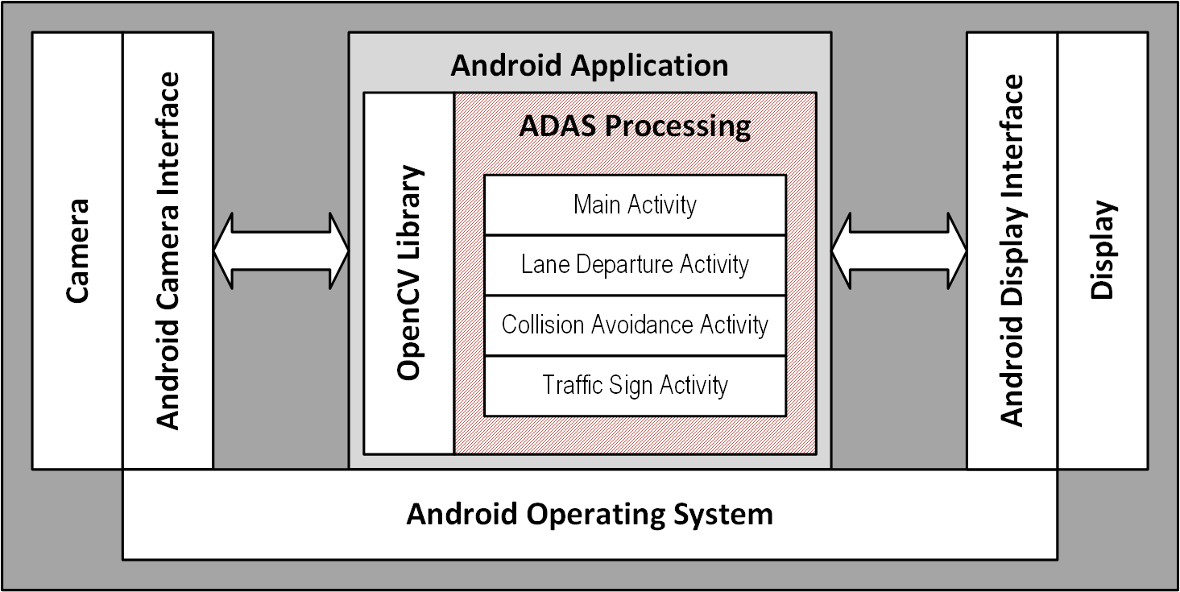
System block diagram
Notes:
Keith

Slide 5
Extensibility
Object Oriented Programming: An OO architecture will help to create an encapsulated, modular software system that can be built on. OO architecture will also help distribute the work across the team members
Event driven architecture: The software architecture will need to have modules that will monitor specific changes in the videos, and trigger functions to process those updates (for ex: speed limit sign comes into view)
Processing Optimization: The target environment does not have very powerful processing power, making it very important to have optimized algorithms for video processing
Notes:
Rak

Slide 6
Modularity
Modular structure: With an OO architecture, each independent function can be partitioned into its own module
This allows for simultaneous development and independent verification activities
Some high-level functions are common across system functions and may need to be completed prior to lower-level functions
Common functions the system performs:
Object identification: The system identifies objects of interest in the picture frame
Object recognition: Once an object is identified, the system classifies it and calls the appropriate sub-function to handle the event
For example, a lane marker is in the picture frame; is there a lane departure event?
Notification: When a significant object or event is confirmed, the sub-function returns the results so the system can notify the driver
Notes:
Rak

Slide 7
Performance
Needs to yield results fast enough to improve driver safety:
Average driver reaction brake time is 2.3 seconds
https://copradar.com/redlight/factors/index.html
Average reaction time in general:
0.25 seconds for visual stimulus
0.17 for audio stimulus
0.15 seconds for touch stimulus
https://backyardbrains.com/experiments/reactiontime
These are the minimum results needed to allow human to react to stimuli
Can the target environment support a sufficient response rate?
Raspberry Pi has limited processing power; suitable for real-time video processing?
Mobile Android platforms represent many configurations; can we guarantee performance results?
Notes:
Adam

Slide 8
Safety & reliability
Safety: ADAS Level 1 (SAE) – Assisted Driving – Minimal Safety Impact
System has no direct control of the vehicle
False Alarms: Will increase driver workload, may result in anomalous driver reaction
Reliability: Degree to which the system is accurate, consistent and available
As an aid, the system does not need to have strict reliability objectives
Accuracy Goal: 75% of detections/alerts are valid and timely
Consistency Goal: 90% of similar events are detected
Availability Goal: Operational 90% of the time in normal daylight driving
Excludes nighttime, adverse weather and bright sunlight/glare conditions
Notes:
Keith

Slide 9
customers
Auto Manufacturers - Computer Vision driving aids can be used as an important safety feature in all types of vehicles. It plays major role in autonomous vehicles
Visually impaired(VI) assistance technology manufacturers - To provide additional support, or possibly replace the long cane and the guide dog
Notes:
Sapana

Slide 10
Stakeholders
Auto Manufactures - Big selling point as it increases car safety
Auto Insurance Companies - If a car could detect danger and stop before accident happens, saves life and property
Everyone who operates car - Safety of the driver and family members, reduces the car insurance because of safety discount
Law Enforcement - Less accidents, less law enforcement involvement
Notes:
Sapana

Slide 11
Impact – reduce accident cost/fatalities
The economic cost to society of speeding-related crashes is estimated by NHTSA to be $40.4 billion per year. In 2007, speeding was a contributing factor in 31% of all fatal crashes, and 13040 lives were lost in speeding-related crashes.
A lane departure fatality occurs every 21 minutes. Total nationwide fatalities in 2006 were 25,082 which is 58% of total crash fatalities.
https://www.crab.wa.gov/LibraryData/RESEARCH_and_REFERENCE_MATERIAL/County_Road_Safety/080401AASHTOLaneDepartureCrashes.pdf
Per U.S.D.O.T 19-23% vehicle crash deaths involves collision with fixed objects and animals.
Notes:
Sapana

Slide 12
Risks and challenges
New platform: team needs to learn and use the Android operating system and environment or the Raspberry Pi and Python; and computer vision algorithms
Performance: does the mobile phone platform or the Raspberry Pi provide enough performance to support this application?
Time: is there enough time in the 13 week semester to complete a significant portion of the project?
Distributed Team: Team will have to overcome geographic distances during integration effort
Notes:
Keith

Slide 13
Team Interactions
Team Meetings:
Regular team meetings on Thursdays 7:00 - 9:00 PM Eastern
Shorter "stand-up" meetings on Sundays 7:00 - 7:30 PM Eastern
Meeting room: SSW690 Google Meet room provided by Prof. Rowland
Whatsapp for messaging in between meetings
Email for longer messages
GitHub repository: https://github.com/Scarabyte/SSW690-Project
Notes:
Adam

Slide 14
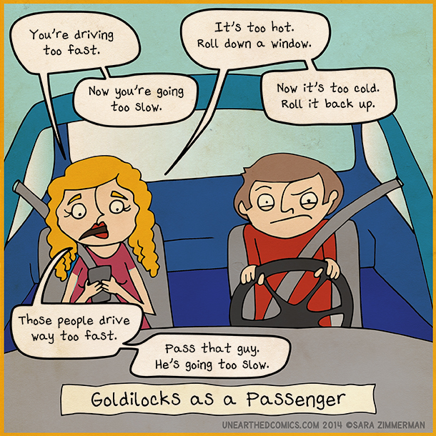
We are… the Back seat drivers!
Source: http://unearthedcomics.com/comics/distracted-driving/ (Creative Commons License)
Notes:
Adam

